Slide 1

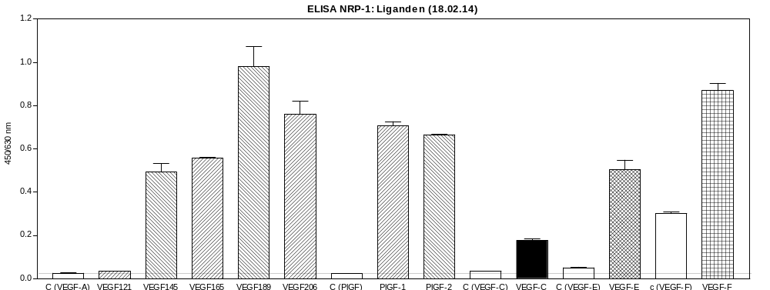
ReliaTech GmbH
Binding of NRP-1 to different ligands
(Cat #S01-019S / -019)
Note: The used antibodies for VEGF-A and PlGF have no background signal, a slight signal is visible for anti-VEGF-C and anti-VEGF-E. In contrast, the anti-VEGF-F shows a very strong background signal. However the signal for VEGF-F is about 2.8X fold stronger so it seems to be specific.
The positive signal für PlGF-1 and is not clear because the literature stated that PlGF-1 (like VEGF121) do not bind to NRP-1. We have not found a clear statement in the literature for binding of VEGF-C to NRP-1.
http://www.reliatech.de / orders@reliatech.de

